Slide 1
Leveraging Census Data
Exploring and predicting post-secondary employment outcomes in the US

Slide 2
What are we looking at?

Slide 3

The US Census Bureau Post-Secondary Employment Outcomes (PSEO)
PSEO is an experimental dataset from the United States Census Bureau
Data coverage is high for only a few states
Tracks earnings and employment outcomes for graduates
Notes:
The US Census Bureau collects many more sets of data than just the 10 year census.
Covers many different areas: housing, economy, race, health, employment
Some suverys don’t have enough data to be a national survey.
PSEO is voluntary for state education systems

Slide 4
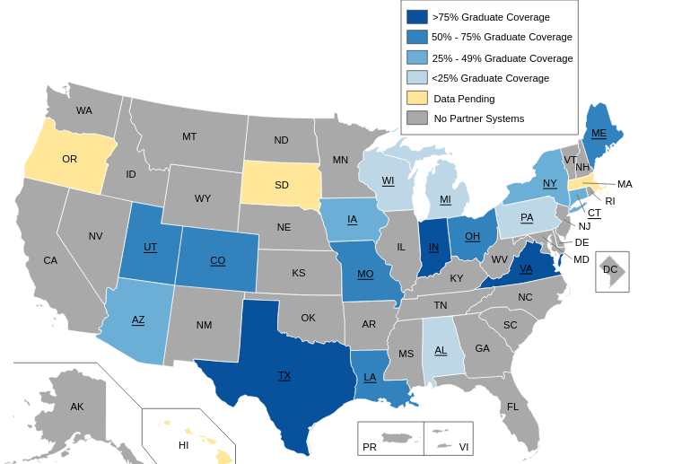
Data Coverage of PSEO dataset
Notes:
Since data is collected through data-sharing partnerships with State and University systems, many states don’t have data.
Texas, Indiana, and Virginia have the most coverage.
UT system and Texas Higher Education Coordinating Board share data for Texas Graduates

Slide 5
The Question

Slide 6
With all this data, what can we do?
Can we train a machine learning model on the available data and use that to predict post-secondary employment outcomes for graduates depending on their institution and degree type?
Notes:
We looked at degree level, type, and institution as predictors of earnings after graduation.

Slide 7
The Database

Slide 8
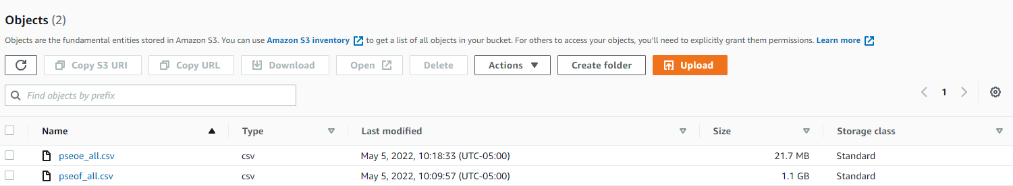
S3 Bucket
Notes:
Data was too big to easily transfer from one place to another, so decided to use S3 bucket to store.

Slide 9
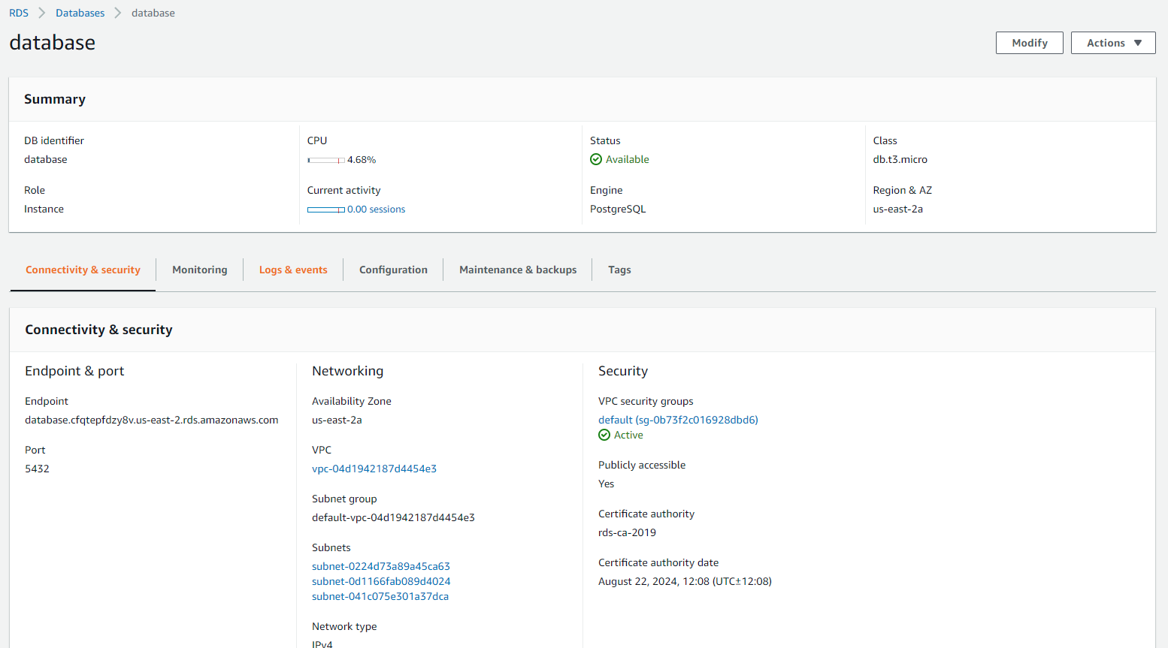
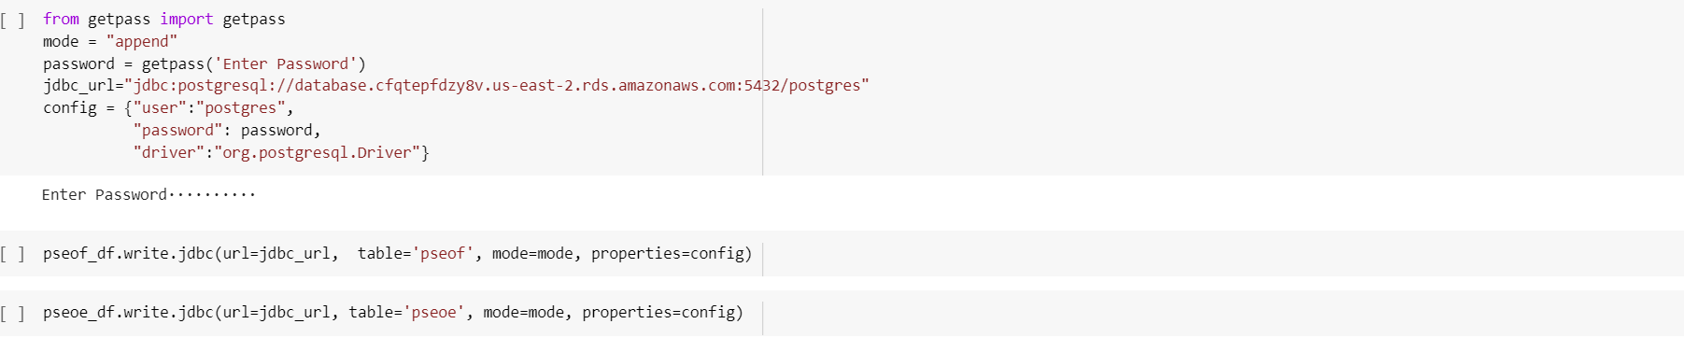
AWS RDS
Notes:
Using AWS RDS, was able to load and upload data to PostgreSQL

Slide 10
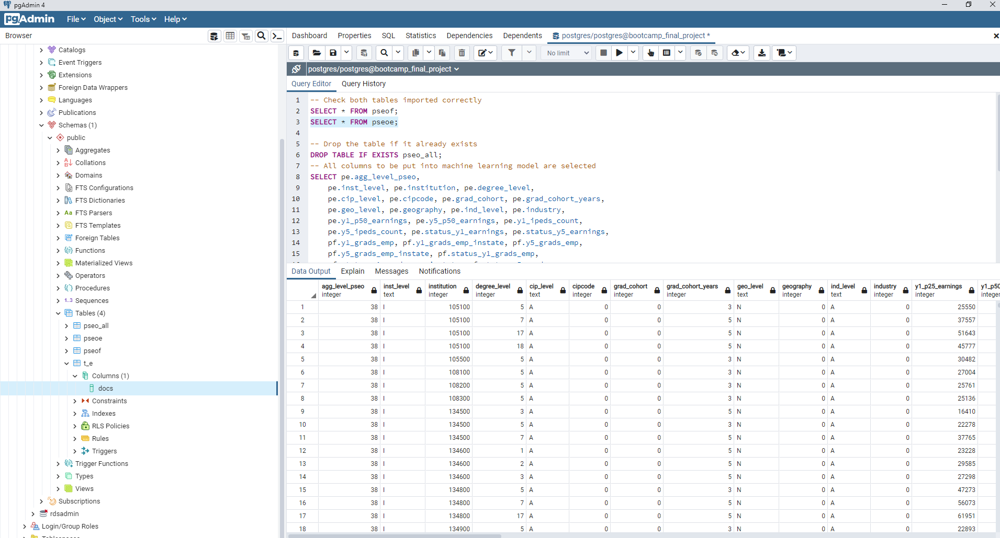
SQL
Notes:
After tables were created, data uploaded, we ran a query to make sure everything was correctly done.

Slide 11
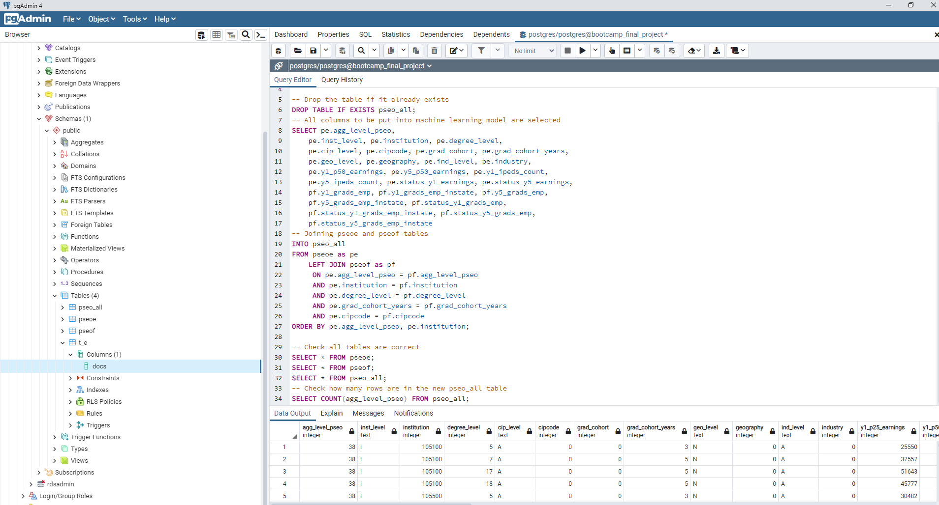
SQL Join
Notes:
Two tables were then joined based on 5 different criteria to ensure the data is joined correctly.

Slide 12
Data Exploration and Transformations

Slide 13
Finding out what each column represents
The names of many columns are vague or unclear. To find out what they stand for we referenced the LEHD Public Use Data Schema.
One of the key variables reviewed is ‘aggregation level’. This is similar to a unit of analysis and aggregates student outcomes at different levels:

Slide 14
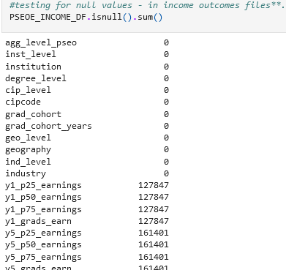
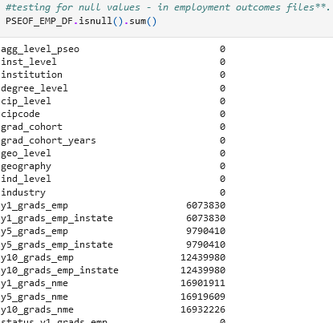
Looking for Null Values
Both the earnings and flows datasets have numerous rows that contain null values.
A subset of columns common to both datasets contain no null values (aggregation level to industry)
Notes:
Here we check for null value counts.
No nulls on certain elements

Slide 15
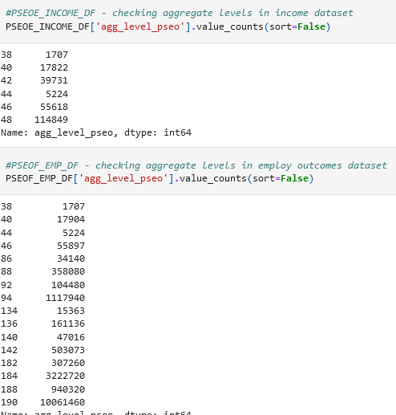
Matching Aggregation Levels
The data documentation indicates that each record is associated with an aggregation level. These aggregation levels indicate the ‘unit of analysis.
For our analysis, we must keep only one unit of analysis that matches across the files.
Notes:
Documentation indicated that aggregation level is unit of analysis.; Focusing on unit of analysis common to both datasets.; We found that only four are common, 38, 40, 44, and 46.

Slide 16
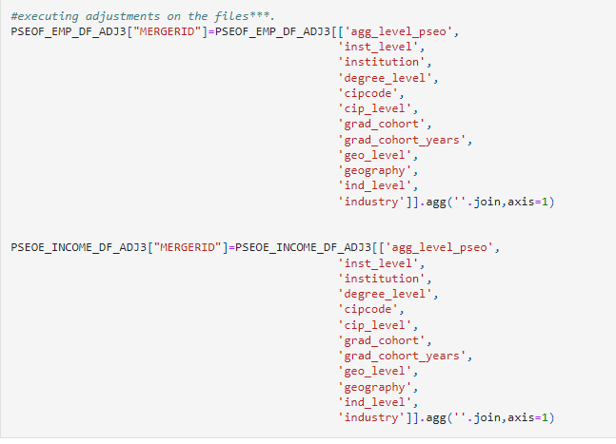
Creation of Primary Key
To keep things easier and cleaner we merged the flows and earnings datasets into one dataset.
Since there is no primary key in the data files, we created one by concatenating column values that satisfied the conditions of having no null values across the data files.
This resulted in a MERGERID variable.
Notes:
There were no null values on certain variables.
We use those variable to create a MERGERID primary key on both datasets*.

Slide 17
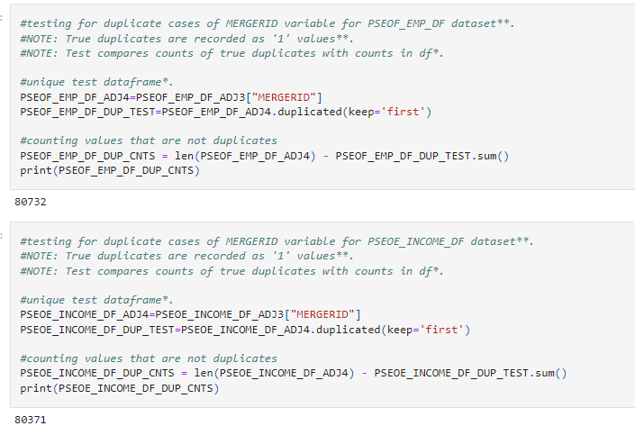
Duplication tests and Merger
Tests were conducted to ensure the MERGERID variables were unique across the datafiles prior to the merger.
No duplicates were detected and the merger was executed.
Prior to the merger, columns with data irrelevant to the analysis were dropped.
Notes:
We test null values on data files after mergerID created
There were 80732 non null in PSOF; 80371 in PSOE.
We test by means of subtraction if no duplicates before merger. No duplicates; and merger is successful.

Slide 18
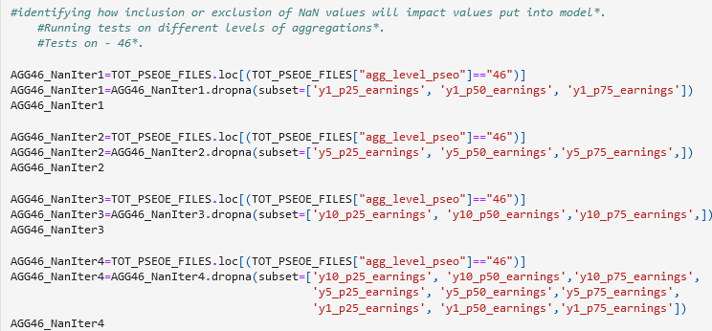
Deciding which columns to keep
We looked at how excluding records containing NaN values in the 1, 5, and 10 year outcome columns affected the data we had remaining.
A series of iterative procedures were calculated to determine how many data values would be lost / retained.
The procedures identified as aggregation level (AKA unit of analysis) 46 was optimal.
Notes:
Tests on value counts suggests that agg level 40, and 46 will give us most counts of values in analysis:
40: 17,822; 46: 55,618. (46 was selected)
Iterative tests were done to see which was optimal.

Slide 19
The Dashboard

Slide 20
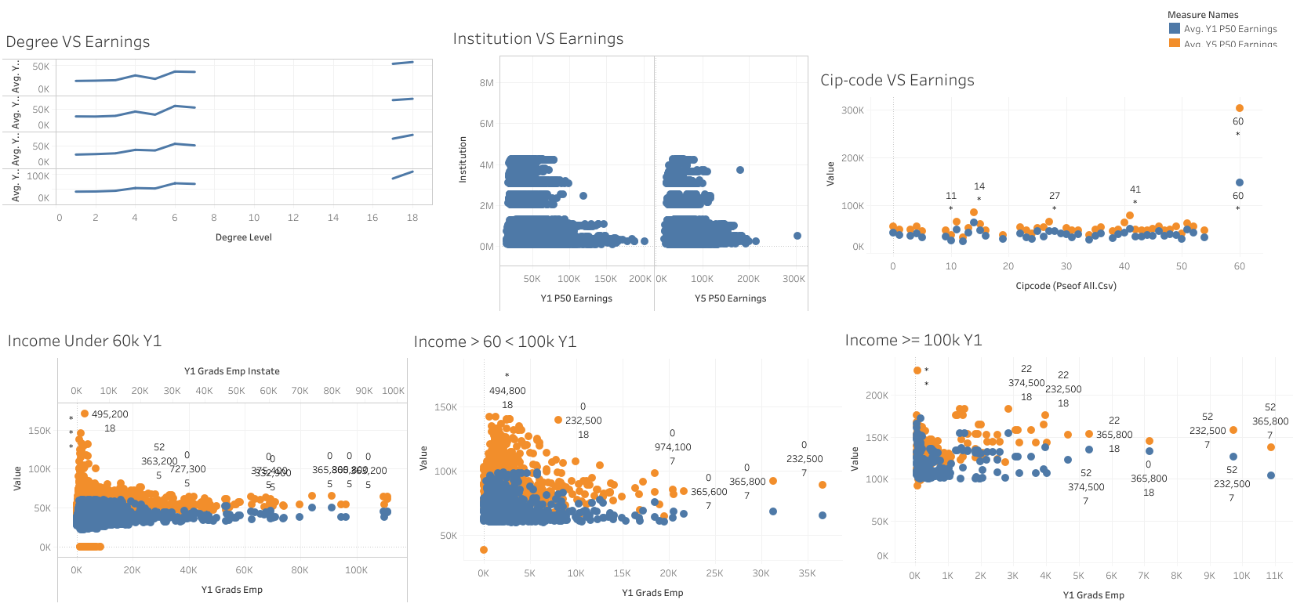
Search by name
Results
Filters
Cat 1
1
2
3
Cat 2
…
…
…
Cat X
Map of United States
Graphs aggregating results
Notes:
After analysis on Tableau, we solidified our theory that the most important factors to one’s earnings are: degree level, institution, and cip-code, all of which are encoded with numbers. Will show you what they are in the next slide. In blue, we have the average earnings of all the groups in the 1st year of employment and in orange, the 5th year of employment. In the degree vs earnings graph you can see that the higher the degree, the higher the average 1st year income. In institution vs earnings, you can see only a handful of institutions can give you an average 1st year income of more than 100k. In cip-code vs earnings, you can see that almost all fields of study are the same except for number 60. Interestingly, we discovered 2 things. 1. If you make more the first year, you are likely to make more the 5th year as well. 2. If you make more than 100k the first year, you income will increase less dramatically than those who make less than 60k the first year.

Slide 21
Tableau Story
https://public.tableau.com/app/profile/james.liu7227/viz/FinalProjectStory_16530613520890/Story?publish=yes
Notes:
Did relationship analysis on several features vs earnings: degree level, aggregation level, grad cohort, and institution. Grad cohort and aggregation level along with other features like geography and industry that have only one unique variable had little to no effect on average income. Whether there’s a high or low percentage of students who were employed in state didn’t seem to matter either. Higher the degree, higher the average 1st year income. Only a handful of institutions can produce students with an average income of more than 60k the 1st year. Almost all fields of study are the same except for residency programs with an average 1st year income of $148k. Here again, we see that it’s more common to see an increase in income of more than 30k in groups that make less than 60k the 1st year.

Slide 22
Highest Average Income Group
https://public.tableau.com/app/profile/james.liu7227/viz/FinalProjectIncomeGroupInteractiveElement/HighestAverageEarningGroup?publish=yes
Notes:
If we take all the highest income groups and mash them together, we get the group who has a masters in a residency program and studied at Texas A&M System Health Science Center with an average 5th year income of $300,000!

Slide 23
Machine Learning

Slide 24
Goal
To create a machine learning model that predicts how much new graduates will make
The model was used to predict income for both the first and fifth year after leaving school

Slide 25
The Model
A neural network was used as it was found to be the most accurate for our project
One iteration of the model attempts to predict income
The other iteration attempts to predict whether or not your income will be more or less than the median income for that year

Slide 26
Results
The model can predict within $6,000 on average what you will make in your first year and within $9,500 for fifth year earnings
The model predicts roughly 78.5% of the time if you will make more or less than the median in your first year, and 77.5% of the time for fifth year earnings

Slide 27
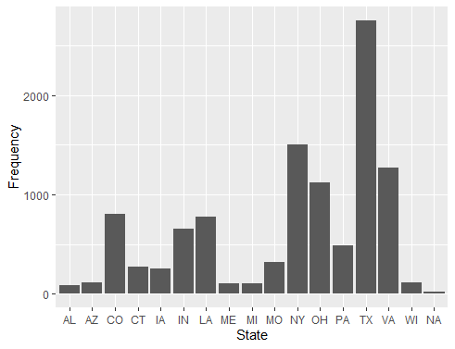
Future Analysis
There were several limitations in our analysis that could be corrected with additional data elements:
1) biased sampling:
Participation in the data sharing partnership used to produce the PSOE and PSEOF files is voluntary.
Fewer than 20 states were represented in the underlying files and participation was heavily skewed towards Texas.
Frequency of representation by State
Notes:
The IPEDS data shows that the vast majority of higher education institutions in the sample population are from TX and VA.
This is because they are the founders of the initiative.

Slide 28
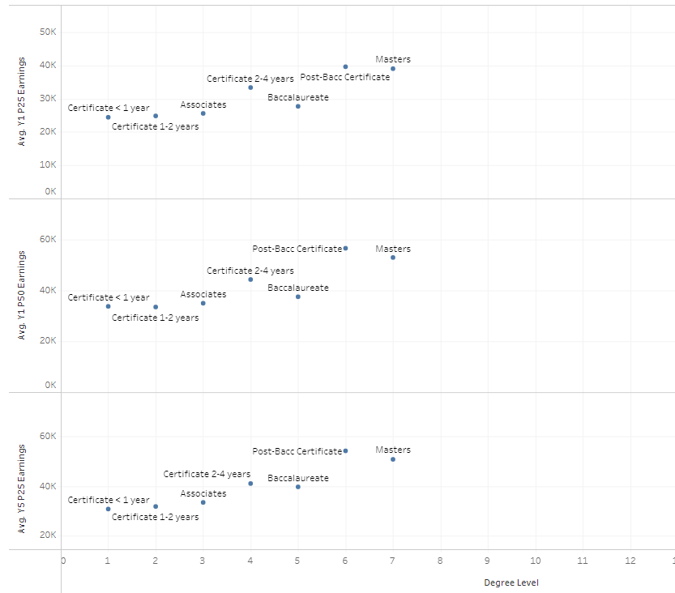
Future Analysis
There were several limitations in our analysis that could be corrected with additional data elements:
2) Lack of Key Variables
The visual shows that some students who received non-degree certificates earned more than those who graduated with a Baccalaureate Degree.
It is likely that students in the certificate cohorts are on average older than those graduating at the baccalaureate level. They may be further along in their career.
AVG earnings by Degree Level 50% quartile after 1st year

Slide 29
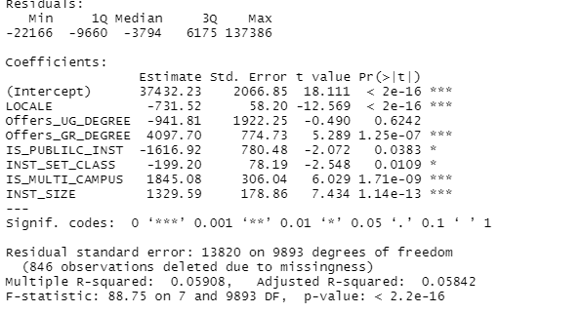
Future Analysis
There were several limitations in our analysis that could be corrected with additional data elements:
3) Inclusion of Institutional Characteristics
Integrated Postsecondary Education Data System (IPEDS) is a collection of data elements on institutions in the US. Data elements include measures of institutional characteristics, Institutional prices / tuition, Admissions, Finances, and others.
Inclusion of these data elements may improve our model.
A preliminary analysis shows that level of urbanity (urban to rural), institution control type (public vs private), and variables associated with institutional size were all strongly associated with income earnings.
Multivariate linear regression of institutional characteristics on income earnings
Notes:
The data includes Local (urban to rural); Undergrad offering status (‘1’ is yes ‘0’ is no); Graduate offering status (‘1’ is yes ‘0’ is no); Is public inst is (‘1’ for public‘0’ for private); INST_SET_CLASS (CARNAGIE classication ordinal variable - lower ranks indicate lower levels of both urbanization and degree levels; IS_MULTI_CAMPUS (‘1’ has multiple campus sites ‘0’ is only one); INST_SIZE is continuous for size of study body.; The statistical sig. Of intercept suggests that additional data points aren’t in this model

